Slide 1

Crook County
Transportation System Plan
Board Hearing
October 15, 2025

Slide 2
REQUESTED UPDATES FROM HEARING #1
Add Juniper Canyon Road Widening as a third option for improving access, safety
  Added as project “JC-3” with cost of approximately $8,000,000
Include approaches to improving safety/mobility for agricultural vehicles
  Added discussion about needs and solutions, including that ag vehicle mobility must be considered with all projects
ODOT submitted comments – primarily recommended updates to costs
  Increased costs of roundabout at Powell Butte Highway/OR 126 to $6M from $3.4M, for example

Slide 3
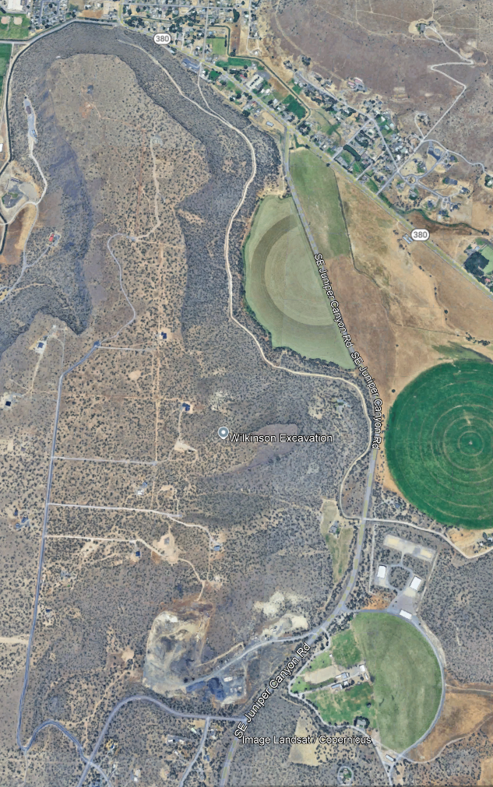
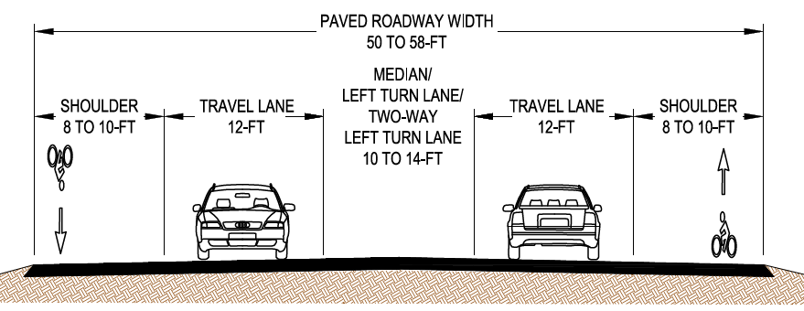
Project JC-3: Juniper canyon Road widening

Slide 4
Hearing #1 slides – as needed

Slide 5
Agenda
Transportation System Plan (TSP) Overview
Existing Issues and Needs
Proposed Transportation System Improvements
Funding and Implementation
Discussion
Next Steps

Slide 6
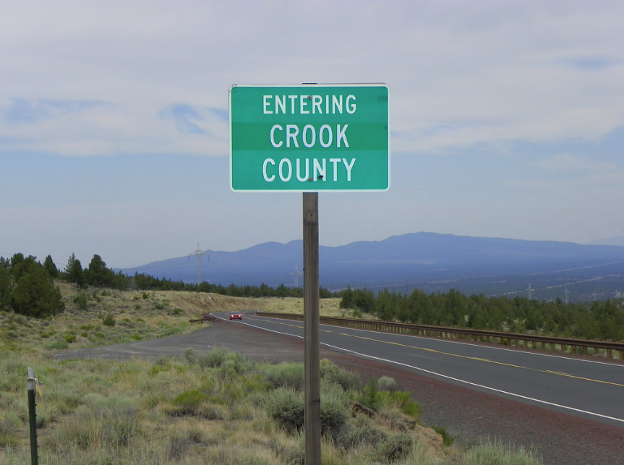
Planning Commission Role
Review key outcomes of draft TSP
Advise on TSP alternatives and recommendations
Recommend TSP to Board of Commissioners

Slide 7
TSP Overview
Introduction to the city of Harrisburg TSP UPDATE

Slide 8
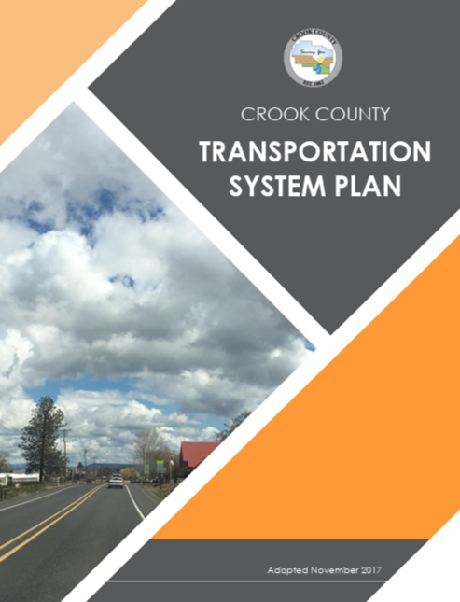
What Is a TSP?
Addresses transportation needs for all modes of travel now and for the next 20 years
Prioritizes projects and helps County comply with state rules
Special focus on:
  Enhancing connectivity and improving safety for all modes of travel.
  Addressing safety issues in areas of congested concern like Powell Butte.
  Developing near-term options for emergency access of Juniper Canyon area.
Updating Crook County’s 2017 TSP

Slide 9
Why are we updating the TSP now?
Growth in the county and surrounding areas has outpaced projections.
Increased demand on the transportation system has increased need to advance projects sooner and evaluate new solutions.
Safety for all modes of travel and increased connectivity are an important focus.
The TSP Update is a focused update to explore these issues.

Slide 10
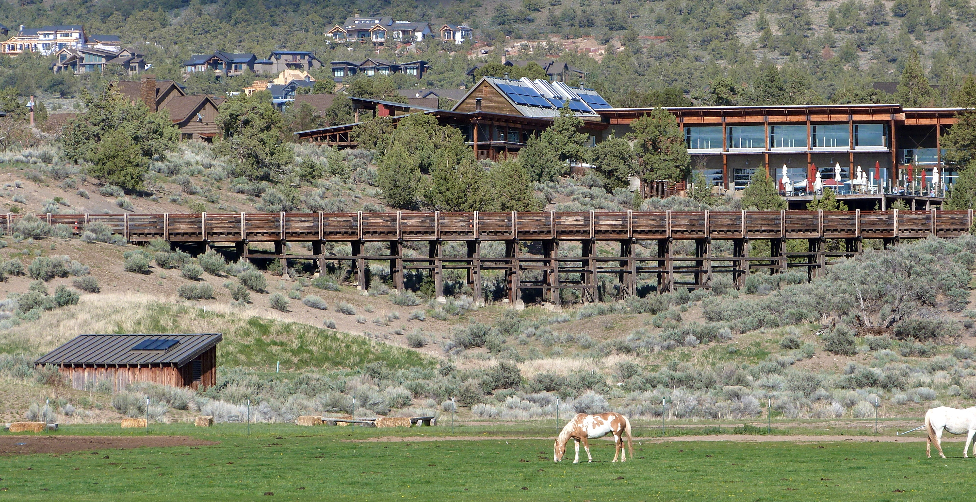
What Is a TSP?
Goals and objectives to guide process
Prioritize projects and programs
Funding options
Compliance with state rules

Slide 11
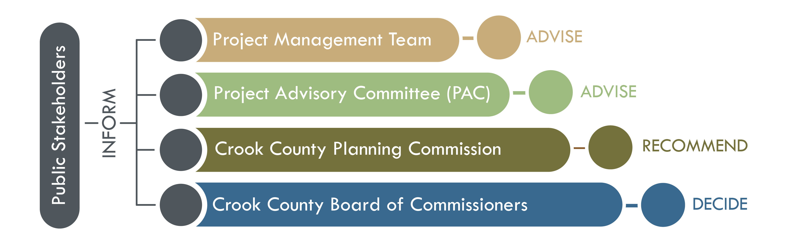
Decision-Making Process

Slide 12
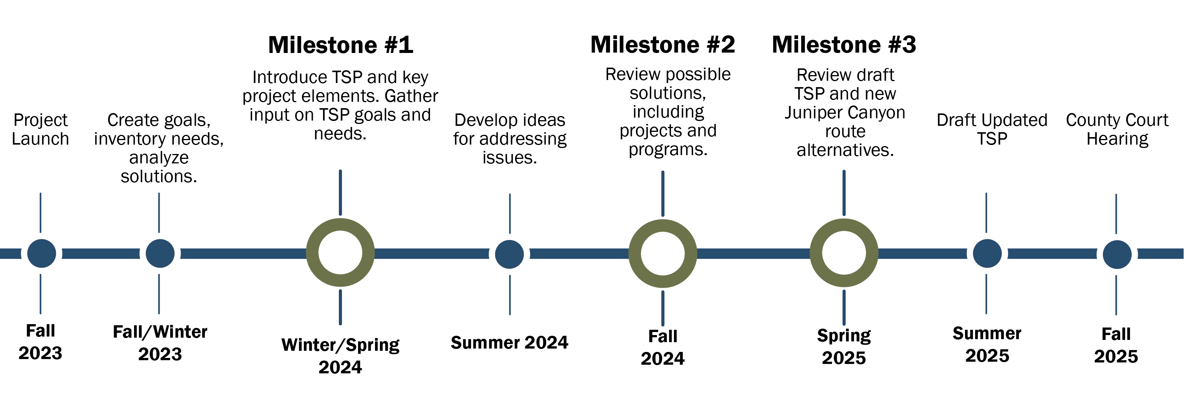
Project Timeline

Slide 13
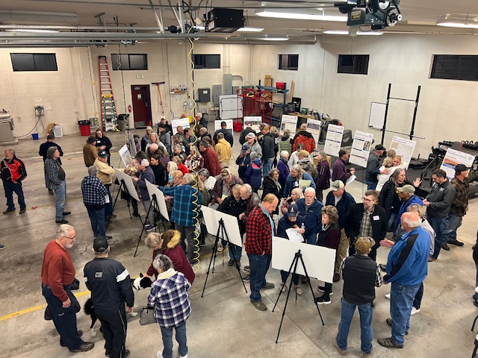
TSP Goals
Mobility and Connectivity
Economic Development
Safety
Multimodal Users
Environment
Planning and Funding
Equity

Slide 14
Engagement
Introduction to the city of Harrisburg TSP UPDATE

Slide 15
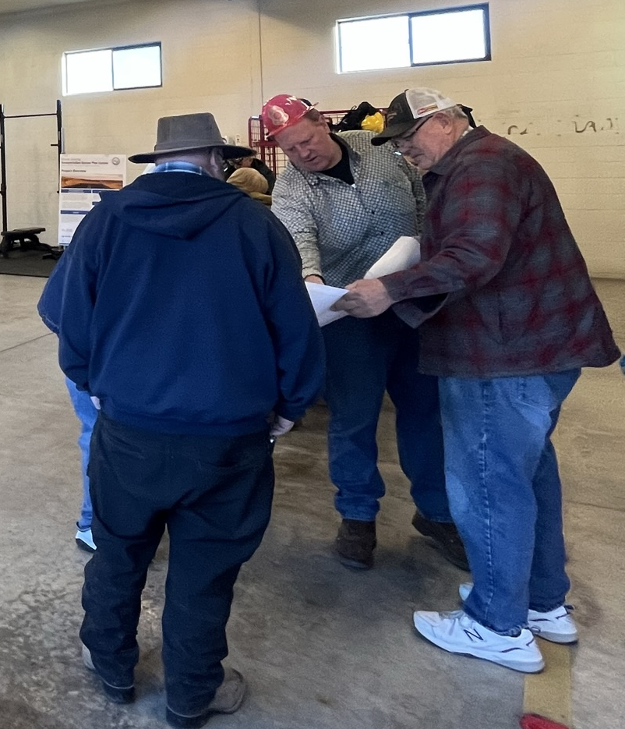
Engagement Activities
Project Advisory Committee– 2 total meetings
Milestone #1 – February 2024
  In-person open houses, survey, and open comment form
Milestone #2 – October – November 2024
  In-person open houses, survey, and open comment form
Milestone #3 – April – May 2025
  In-person public meeting, open house, survey, and email responses
August 2025 – Juniper Canyon Meeting

Slide 16
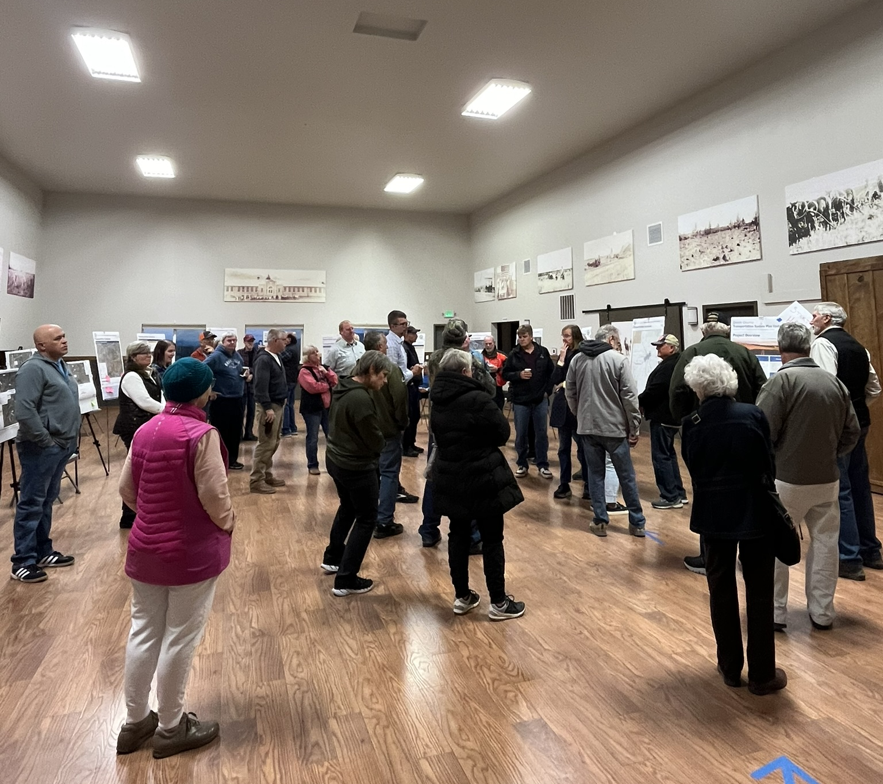
Engagement Feedback
More than 500 people attended events, responded to surveys, and shared input
Transportation Safety is the top community priority
Top Project Priorities:
  SW Powell Butte Hwy and OR 126 intersection
  Juniper Canyon Access
Notes:
Significant interest in building projects as soon as possible
Strong desire to reduce speeding, improve enforcement
Limited community support for new funding sources that would increase costs for residents

Slide 17
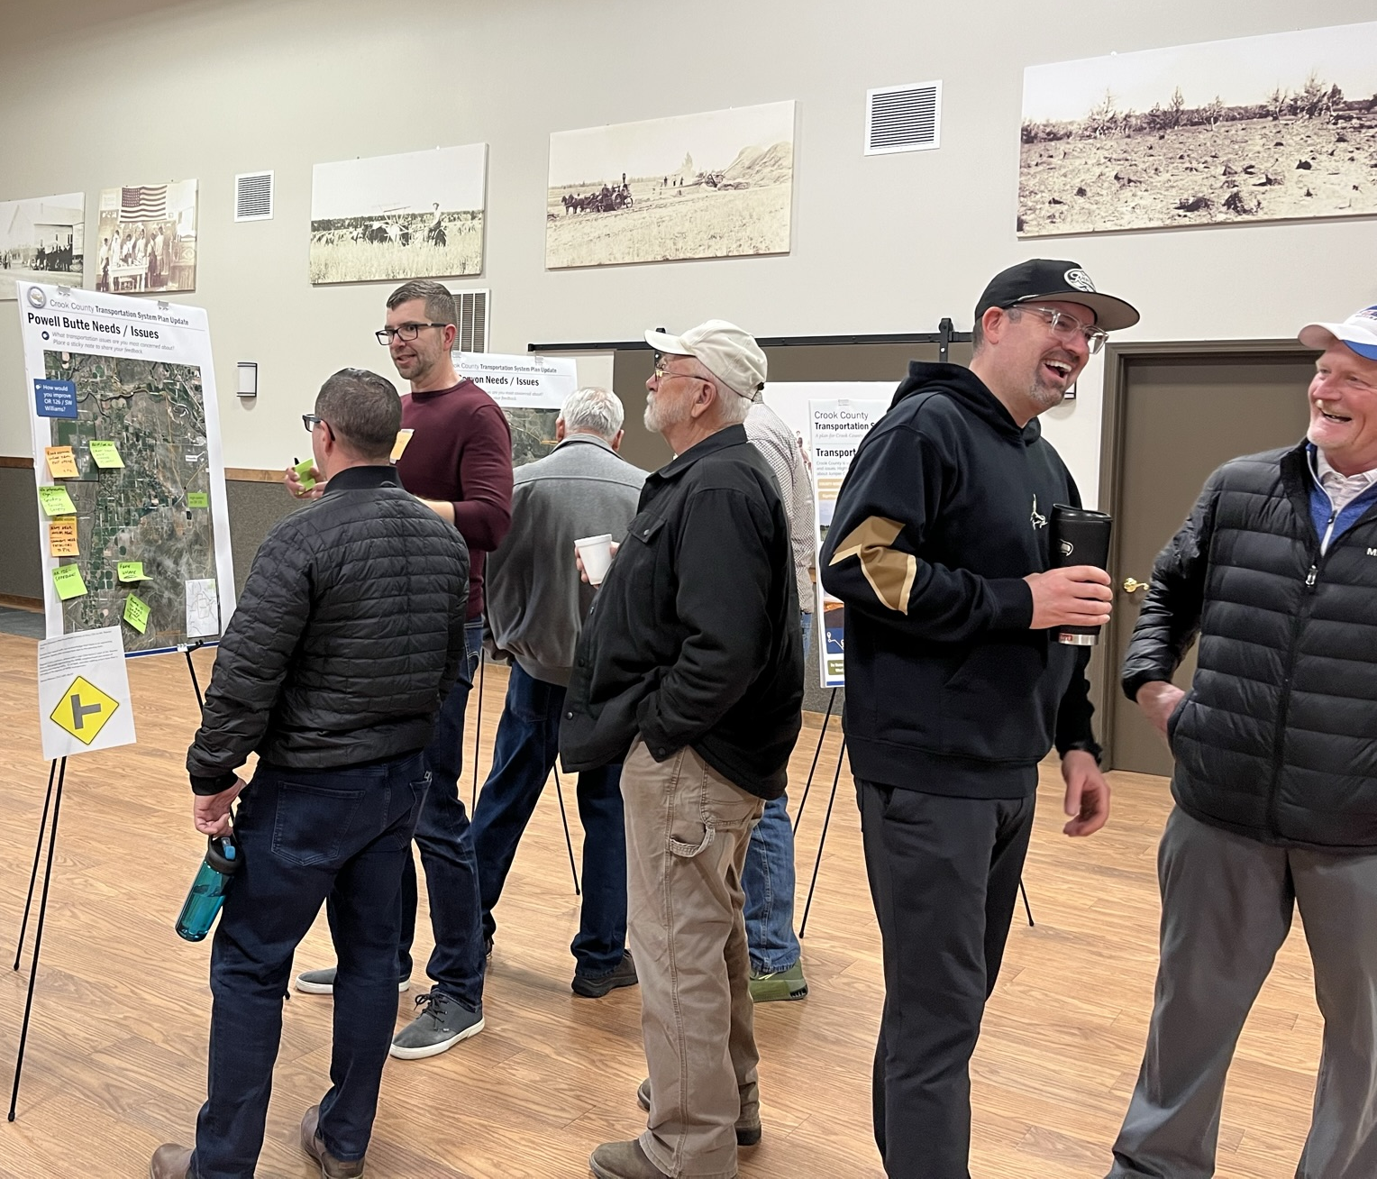
Engagement Feedback
More than 90% of participants confirmed projects align with community priorities
Other Key Findings:
  Significant interest in building projects as soon as possible
  Strong desire to reduce speeding, improve enforcement
  Limited community support for new funding sources that would increase costs for residents

Slide 18
Needs and Issues
Introduction to the city of Harrisburg TSP UPDATE

Slide 19
Needs and Issues
Significant growth has outpaced previous projections, including Powell Butte, Juniper Canyon, Brasada Ranch, and data center traffic.
Growth is resulting in increased traffic speeds, volumes, and safety concerns
Only one way to reach Juniper Canyon limits access and emergency response, impacts traffic

Slide 20
Recommended Improvements

Slide 21
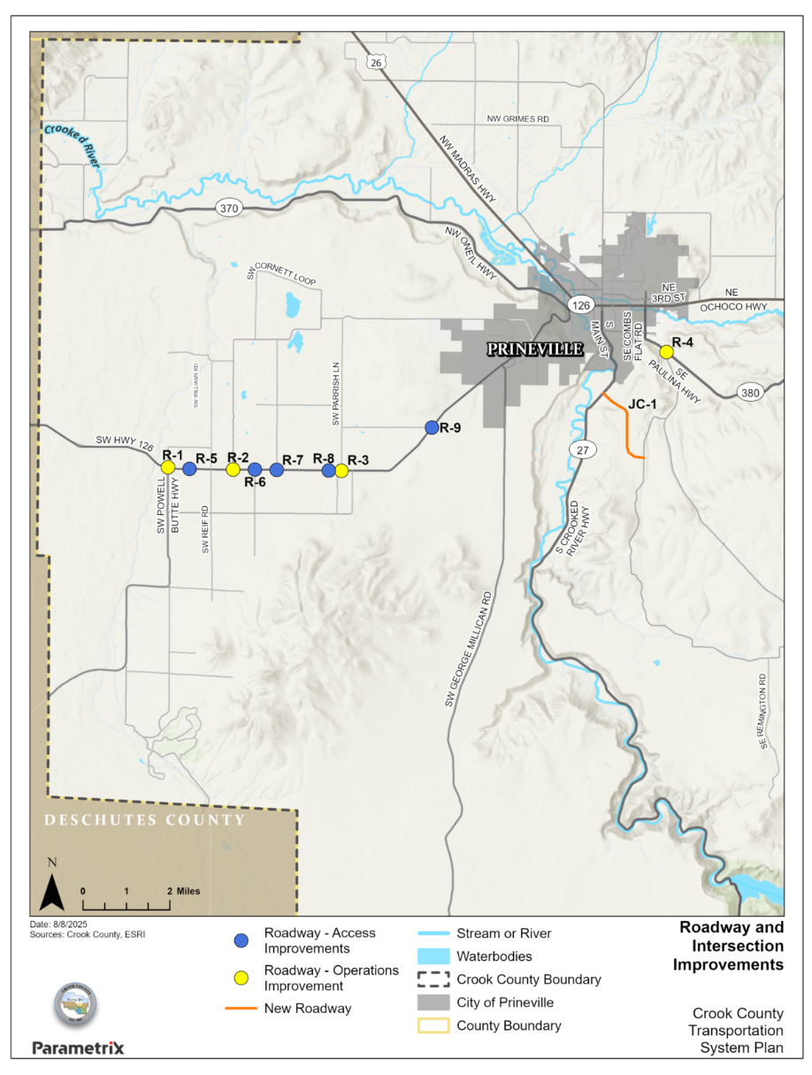
ROADWAY AND INTERSECTION IMPROVEMENTS
Intersection and Operations Improvements
Access Management
Bridge Improvements

Slide 22
Project R-1A:
OR 126 and SW Powell Butte Highway
Recommended Alternative:
Single-lane roundabout
  Maintains turning movements
  Reduces turning conflicts.
  Reduces traffic delays in the near term.
  Provides easier navigation of intersection.
  Expected to cost less than dual lane roundabout.
  Cost: $3,400,000
Key issues:

Slide 23
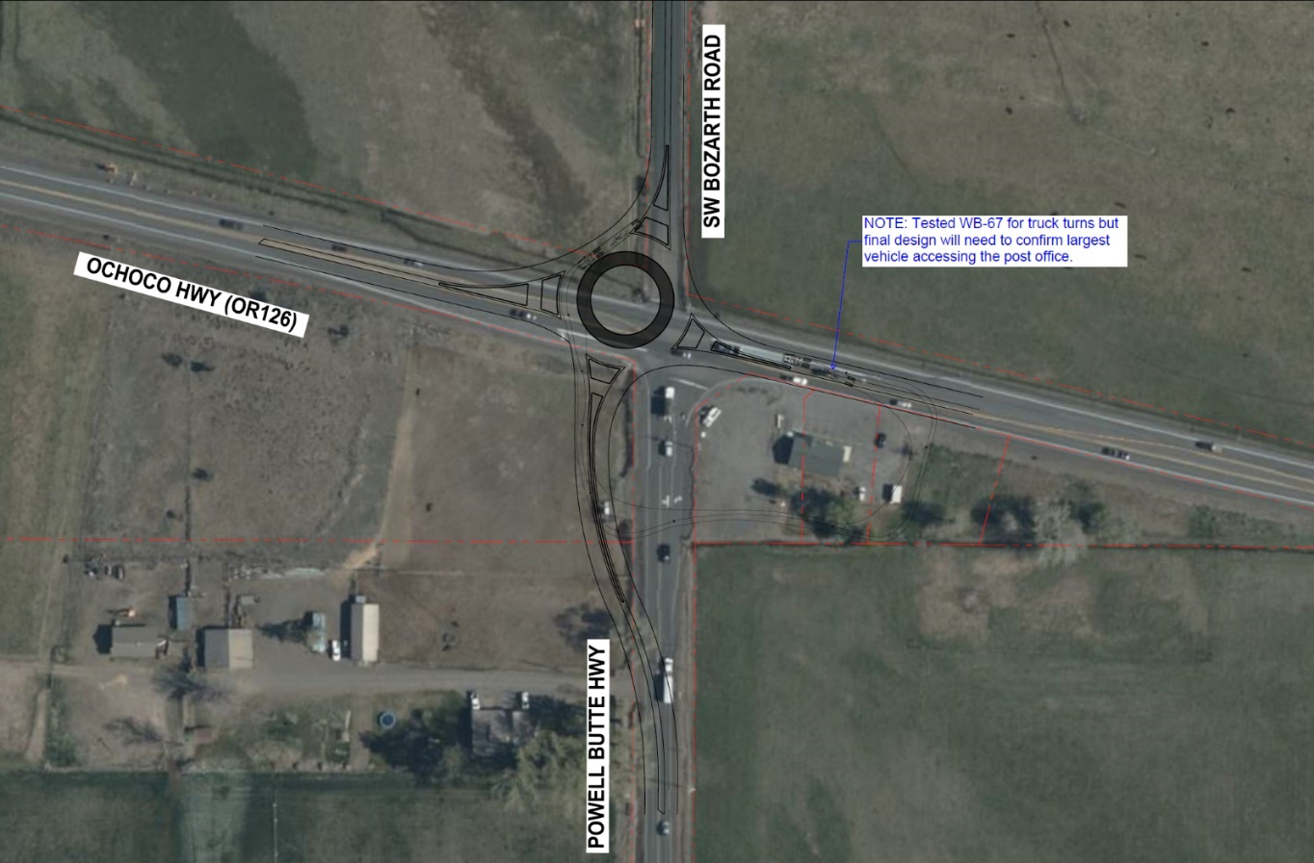
Project R-1A:
OR 126 and SW Powell Butte Highway
Solution: Single-lane roundabout
  Maintains turning movements
  Reduces turning conflicts.
  Reduces traffic delays in the near term.
  Provides easier navigation of intersection.
  Expected to cost less than dual lane roundabout.
  Cost: $3,400,000
Notes:
Safety – collisions at this intersection
Post office access
Delays for turning vehicles
Intersection is forecast to not meet ODOT’s standard for congestion

Slide 24
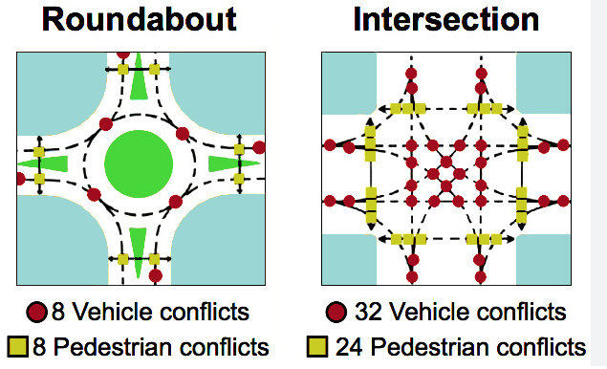
Roundabouts – how do they improve safety and congestion?
Designed to slow entering traffic (20MPH or less)
Reduce congestion by allowing better vehicle throughput
  Often better than signals
Reduce conflict points = improved safety
Lower operations/maintenance cost
Designed for large vehicles/trucks/trailers

Slide 25
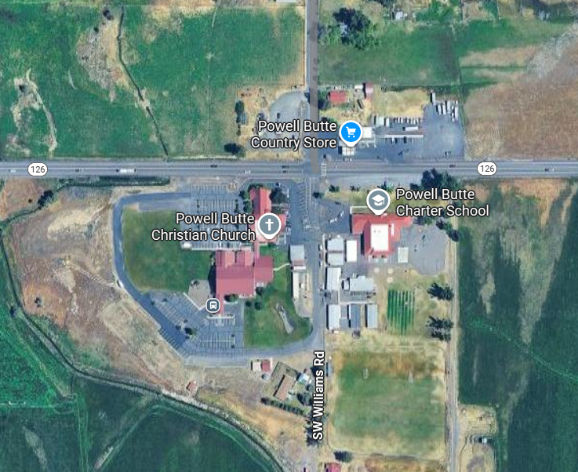
Project R-2: OR 126 and SW Williams road
Key issues
Intersection is forecast to not meet ODOT’s standard for congestion
School, other destinations at this intersection
Speeding and safety
Solution: Single-Lane Roundabout
  Improves safety performance for all modes
  Provides traffic calming
  Cost: $3,400,000

Slide 26
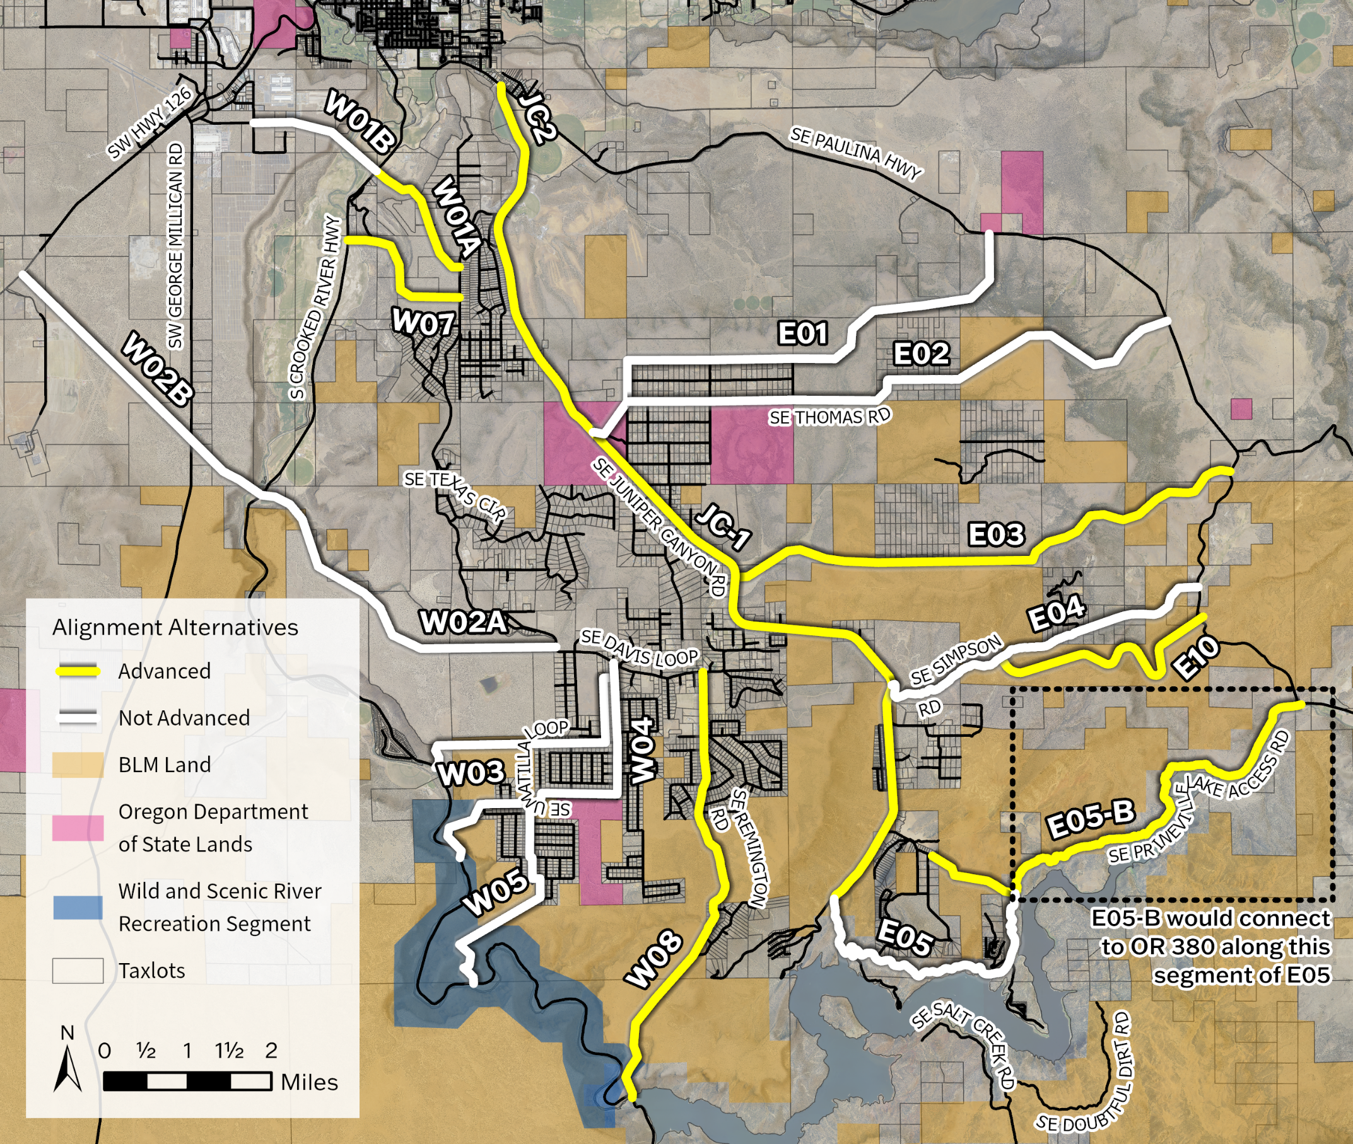
Project JC-1 and JC-2: Juniper Canyon Access
Key Issues:
Juniper Canyon community is growing; in recent years, ~50 new housing units / year
One main access road – limits:
  Options if route is closed
  Emergency response
  Evacuation routes
Increased congestion through Prineville

Slide 27
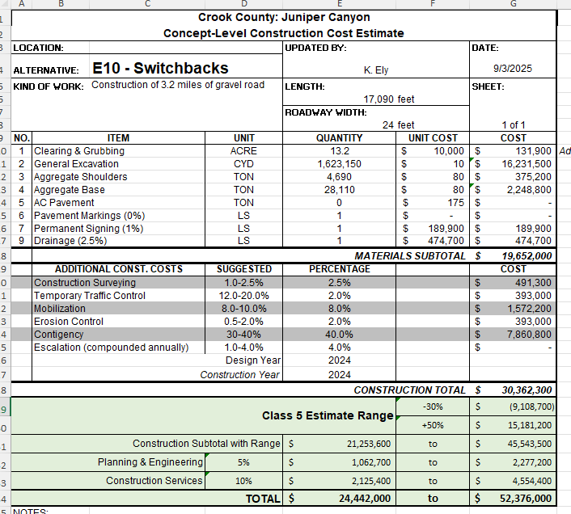
Cost Estimates
Cost estimates are “planning-level,” based on limited information and assumptions
Greater design detail = greater cost certainty
These estimates have substantial contingency and -30%/+50% range to account for uncertainty

Slide 28
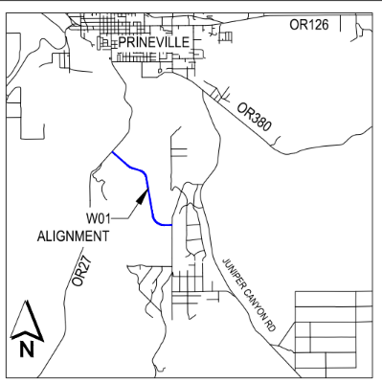
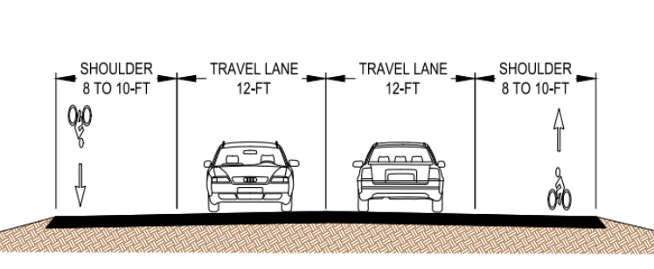
Project JC-1: Juniper Canyon Access
Solution: W01
  Previously vetted alternative
  Helps relieve congestion along SE Juniper Canyon Road.
  Provides additional travel options for emergency response.
  Cost: $6,090,000 to $13,050,000

Slide 29
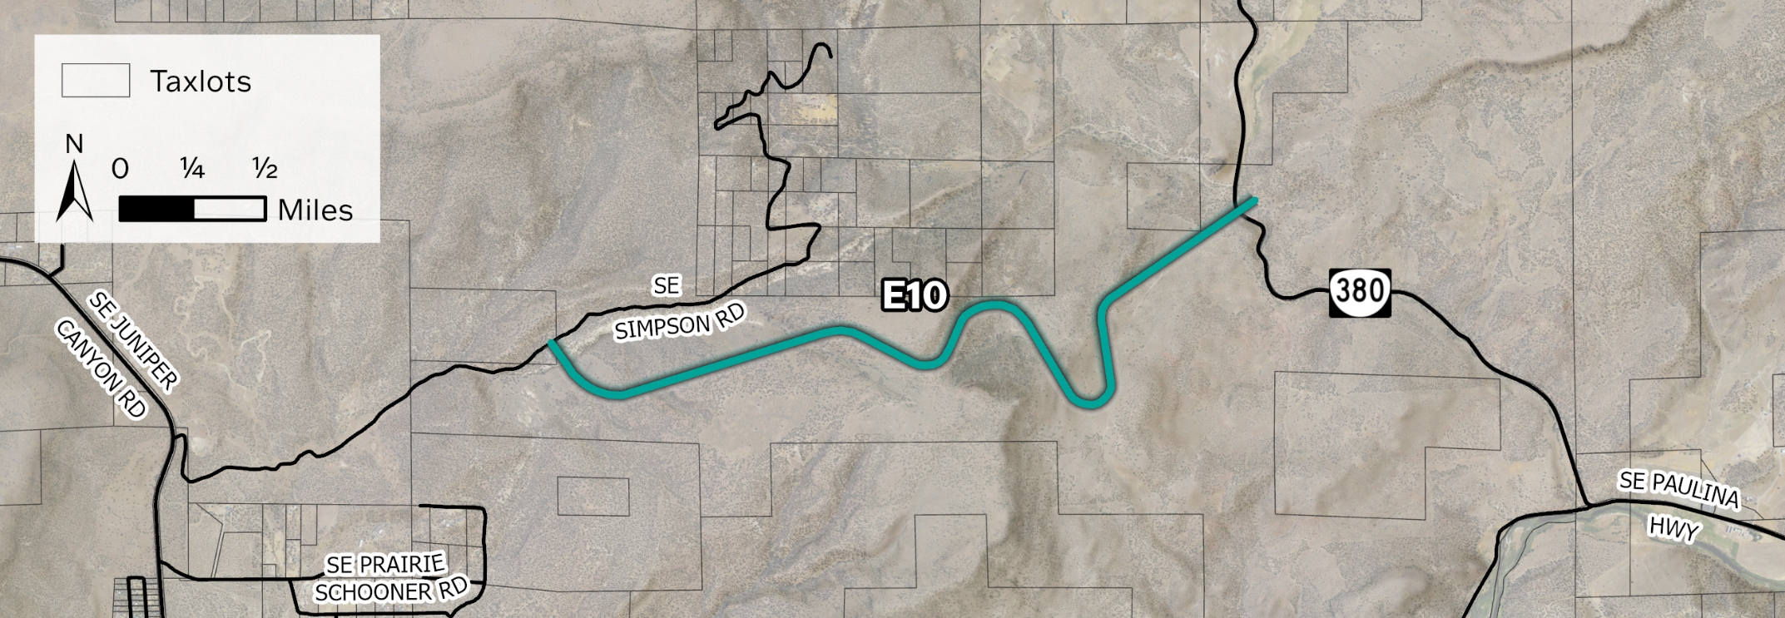
Project JC-2: Juniper Canyon Access
Solution: E10
  Gravel roadway – provide emergency evacuation route
  Located primarily on BLM land
  Cost: $24M to $52M

Slide 30
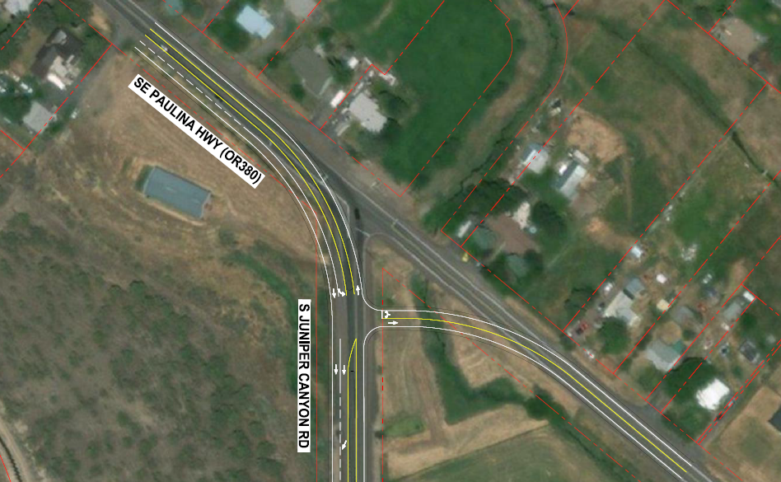
Project R-4: SE Juniper Canyon Road and OR 380
Key issues:
Current configuration is skewed, limited sight distance
Difficult turning movements from SE Juniper Canyon Road
Intersection is forecast to not meet ODOT’s standard for congestion
Solution: Realign intersection, acceleration lanes
Improves intersection safety
Retains existing movements, would accommodate farm/freight vehicles
Reduces conflict points
Reduces traffic congestion
Cost: $2,100,000

Slide 31
Project R-3: OR 126 and SW Parrish Lane
Solution: Widen OR 126 from SW Valley View Road to Stillman Road and include center two-way left turn lane
Reduces traffic congestion and delay
Opportunity to add medians/physical markers to encourage slower driving
Cost: $900,000
Key issues:
Intersection is forecast to not meet ODOT’s standard for congestion
No dedicated left turn lane to access SW Parrish Lane
Notes:
Expected to exceed mobility targets in future no build higher growth scenario
Analysis of future traffic conditions shows that this location would meet turn lane warrants.

Slide 32
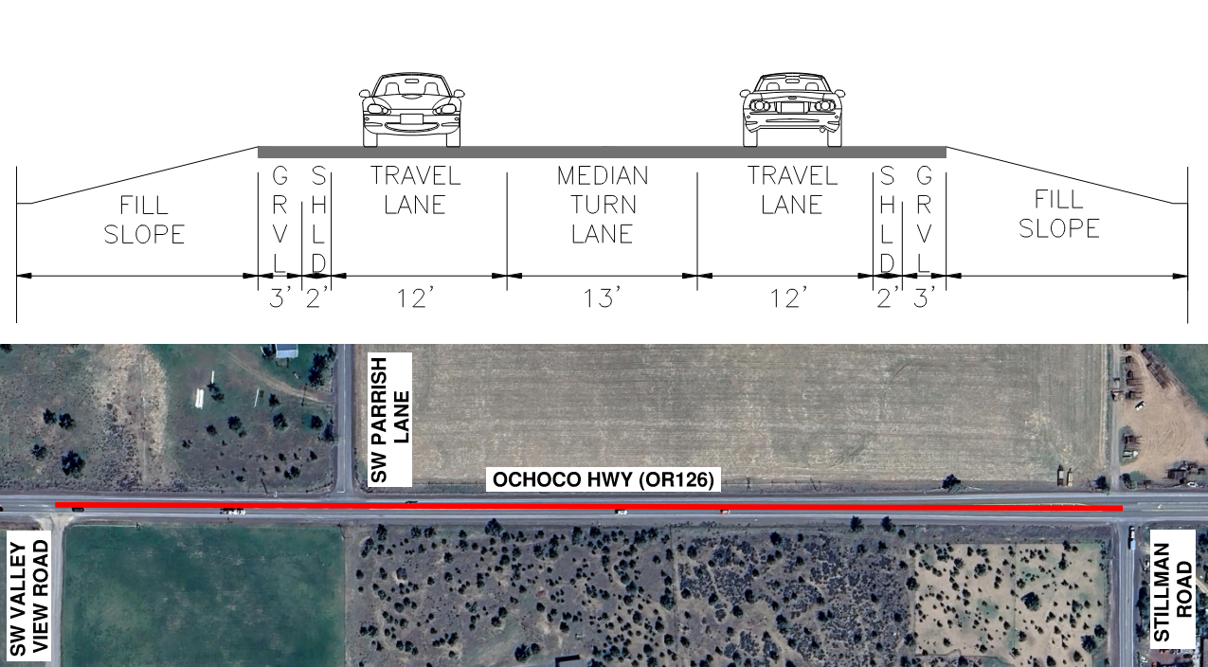
Widen OR 126 and include center two-way left turn lane

Slide 33
Bridges
Replace
SW Powell Butte Highway over Powell Butte Canal
SW Powell Butte Highway over Powell Butte Wasteway
Johnson Creek Road NE over Ochoco Main Canal
Continue
Non-NBI bridge replacement program
  Replace one non-NBI bridge per year
Study
Repairing or replacing County Road 221 bridge over Paulina Creek

Slide 34
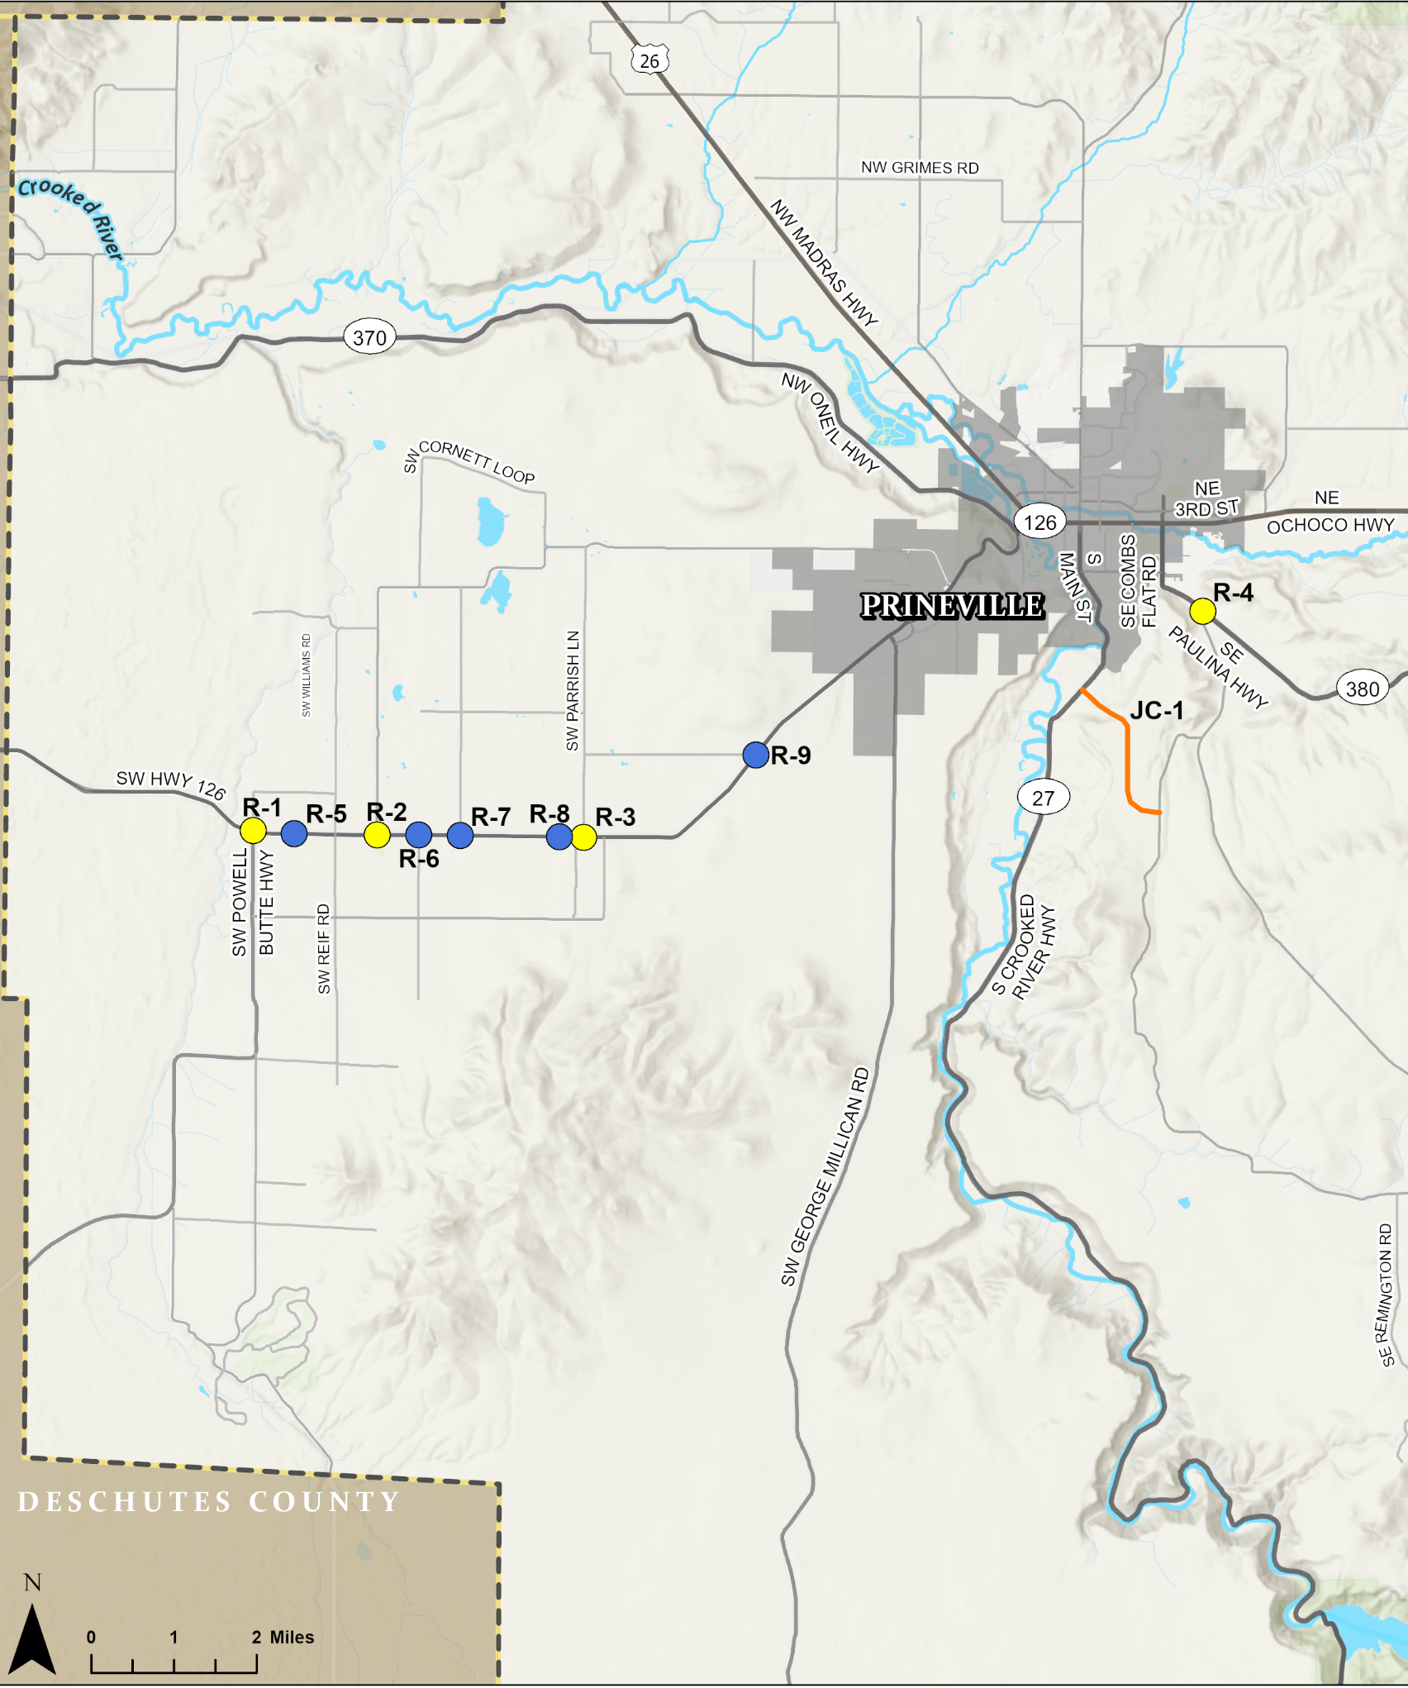
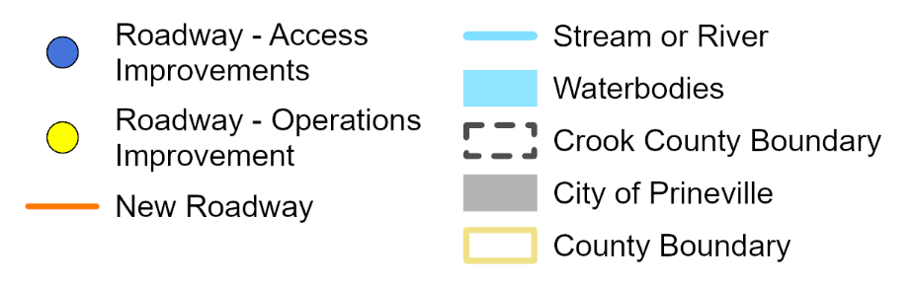
Roadways and
Intersections
Access Improvements
OR 126 at:
  Kissler Rd
  Copley Rd
  Minson Rd
  Yates Rd
  Wiley Rd
New Roadway
Preferred Alignment: W01
Operations Improvements
OR 126 & PB Hwy
OR 126 & Williams Rd
OR 126 & Parrish Ln
Juniper Canyon Rd & OR 380

Slide 35
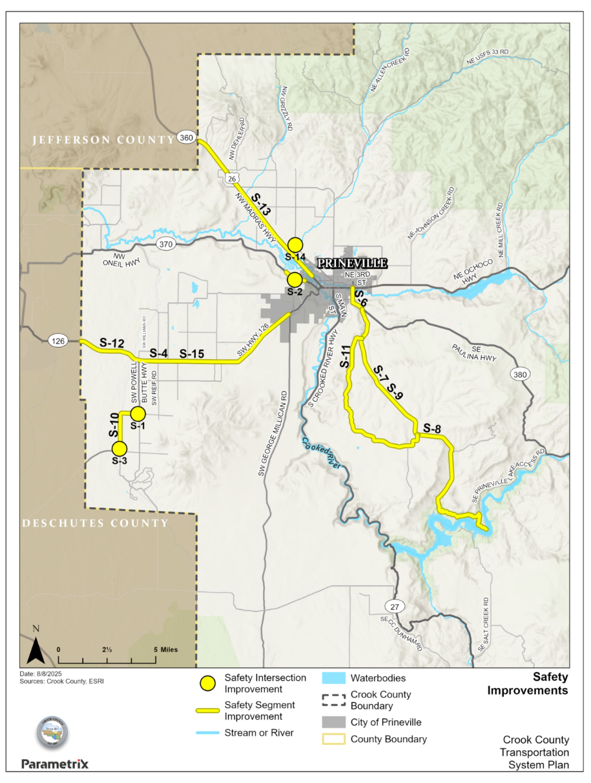
Safety IMPROVEMENTS
Projects address:
  Locations with higher-than-expected crash rates
  Community input
  2017 TSP Safety Improvements
Notes:
Visibility and awareness
Roadway / curve navigation
ODOT standards
Speeding
Crashes / roadway departures
Nighttime driving and inclement weather
Potential conflicts

Slide 36
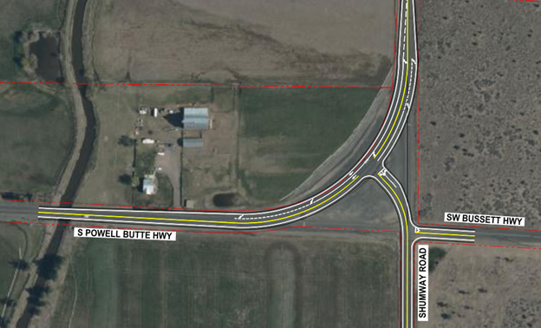
Solution: Realign intersection and install acceleration lanes
Improves visibility and awareness. Simplifies travel patterns.
Responds to and mitigates inclement weather conditions and associated safety challenges.
Reduces roadway departure crashes.
Cost: $870,000
PROJECT S-1: S POWELL BUTTE HWY AND SW BUSSETT ROAD
Notes:
Key issues:
Exceeds critical crash rate
Poor visibility
High travel speeds

Slide 37
Safety IMPROVEMENTS
S Powell Butte Highway and SW Bussett Road
Rimrock Acres Loop and OR 370
S Powell Butte Highway and Alfalfa Road
OR 126 east of SW Powell Butte Highway to Copley Road
OR 370 east of Happy Hollow Drive
OR 380 south of NE 3rd Street
SE Juniper Canyon Road (S-7, S-8, S-9)
S Powell Butte Highway
SE Davis Loop
OR 126 (S-12, S-15)
US 26
NW Lamonta Road

Slide 38
SAFETY IMPROVEMENTS
Treatment | Benefit or Impact | Example Location
Rumble strips, raised pavement markings, or edge line striping | Improves visibility and awareness Enhances roadway navigation | OR 126
Curve chevrons or guardrail | Improves visibility and awareness Reduces roadway departure crashes | Rimrock Acres Loop and OR 370
Variable speed limits | Responds to inclement weather | SE Juniper Canyon Road
Speed feedback signs* | Improves awareness. Encourages speeding drivers to slow down. | OR 126
Lighting | Improves visibility and awareness | S Powell Butte Highway and Alfalfa Road
Remove trees in clear zone | Reduces fixed-object crashes with trees | Davis Loop
*Requires coordination with/approval by ODOT when on state route

Slide 39
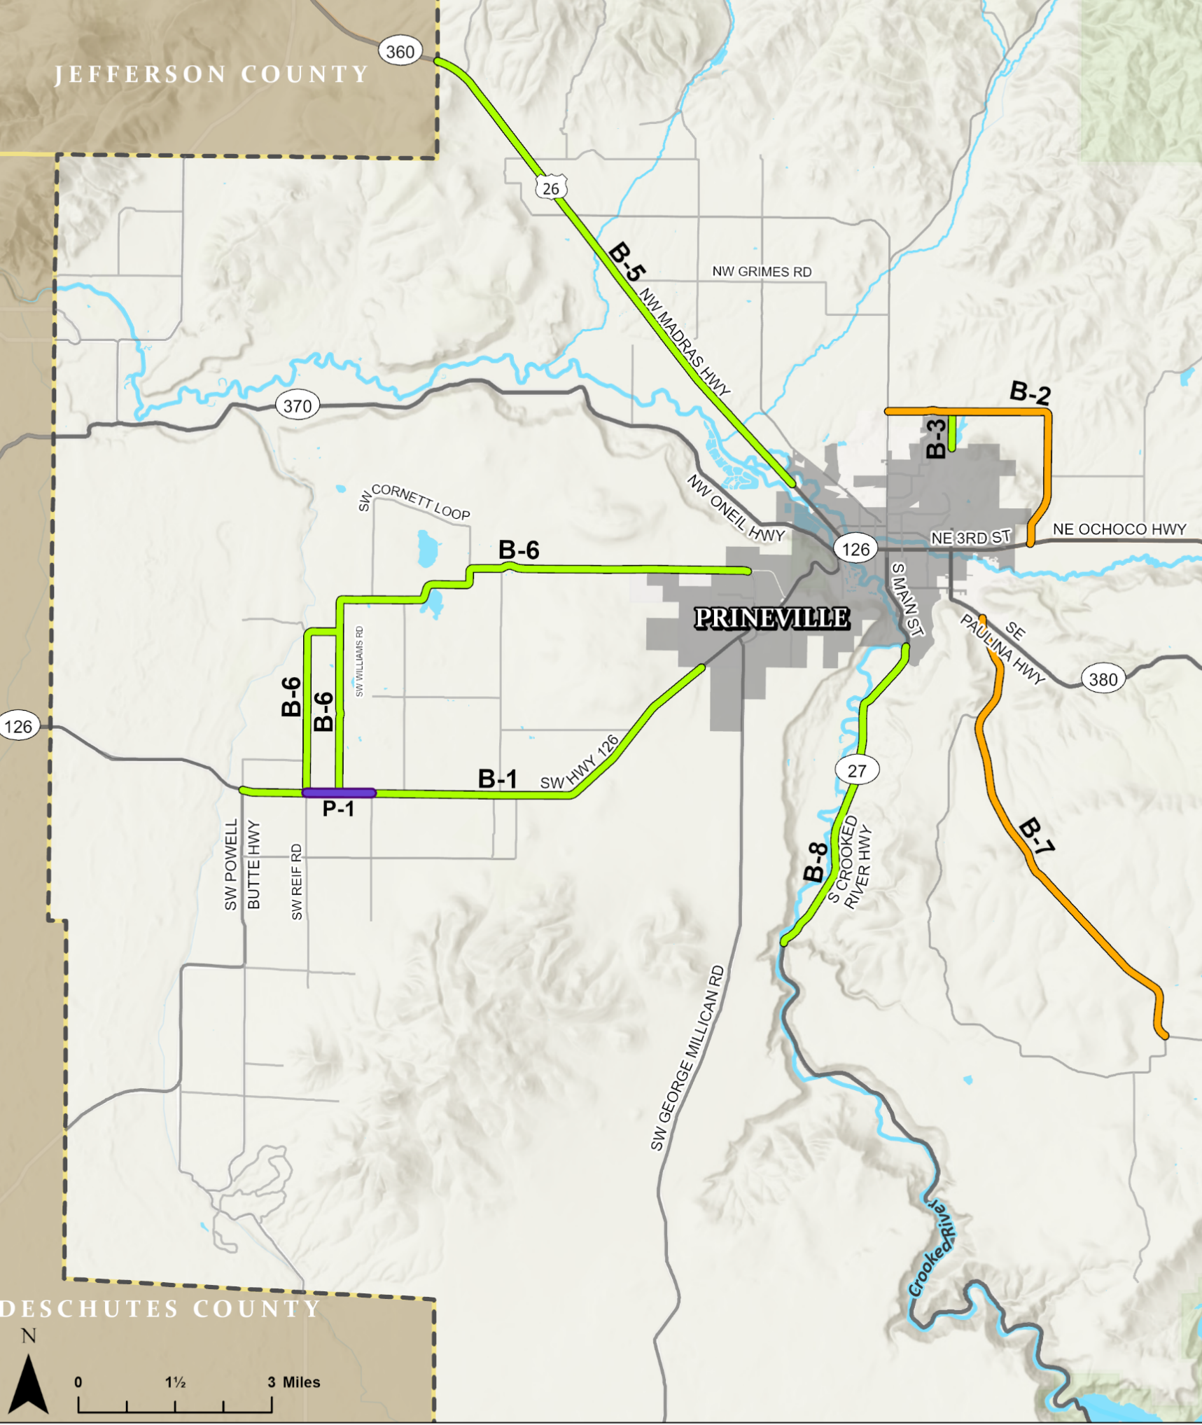
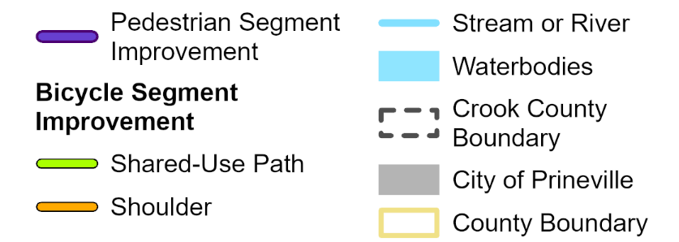
ACTIVE TRANSPORTATION
IMPROVEMENTS
Install sidewalks, curb, gutter, curb ramps, lighting, marked crosswalks
OR 126 and SW Williams Road
Install shared-use path
OR 126 from SW Powell Butte Highway to Prineville UGB
Barnes Butte Road to Iron Horse path
US 26 from existing path to County line
Houston Lake Road, SW Williams Road, Reif Road
OR 27 to planned path in Prineville

Slide 40
ACTIVE TRANSPORTATION
IMPROVEMENTS
Add paved shoulders
Barnes Butte Road
SE Juniper Canyon Road
Construct bicycle hub (rest stop)
OR 27 Scenic Bikeway corridor
Add bicycle route signage
Countywide
Notes:
Construct a bicycle hub, or "rest stop," for hikers, bicyclists, recreationalists, and community members along the OR 27 scenic bikeway corridor; provide small shelter, information kiosk (map/community calendar), bicycle tool station, and bench/sitting area.

Slide 41
Public transportation Improvements
Project Descriptions
Cascades East Transit Service Enhancement Plan | Institute evening and Saturday limited circulation as part of Route 26 flex-route
Fixed route enhancements | Increase service in Prineville with eventual deviated fixed route or a purely fixed route to provide connections to more destinations.
Dial-A-Ride enhancements and Transportation Network Company (TNC) encouragement | Improve accessibility for residents in rural Crook County through a larger service area for dial-a-ride service. Additionally, incorporate TNC elements into the current Dial-A-Ride system.
Transit community outreach | Educate the community about connections available within Redmond and Prineville to reach key destination such as Central Oregon Community College (COCC), the Redmond Airport, the hospital, and additional locations within Bend.

Slide 42
Freight
Project Location | Project Description
Bus Evans Road and Elliott Lane reconstruction to freight route standards | Reconstruct Bus Evans Road and Elliot Lane to freight route standards, with 12-ft lanes, 2-ft shoulders on each side, including 17.14 feet of rock shoulder, and the appropriate roadway base. Bus Evans Road and Elliott Lane reconstruction to freight route standards
US 26 railroad bridge feasibility study | Conduct a feasibility study regarding the reconstruction of the US 26 railroad bridge or lowering of OR 126 to accommodate oversized loads on US 26.

Slide 43
Related Prineville TSP projects

Slide 44
Overview
Prineville completed their TSP update earlier this year
Includes a number of projects that improve east-west connections
Major investment proposed in West Y
New street connections that take pressure of 3rd Street

Slide 45
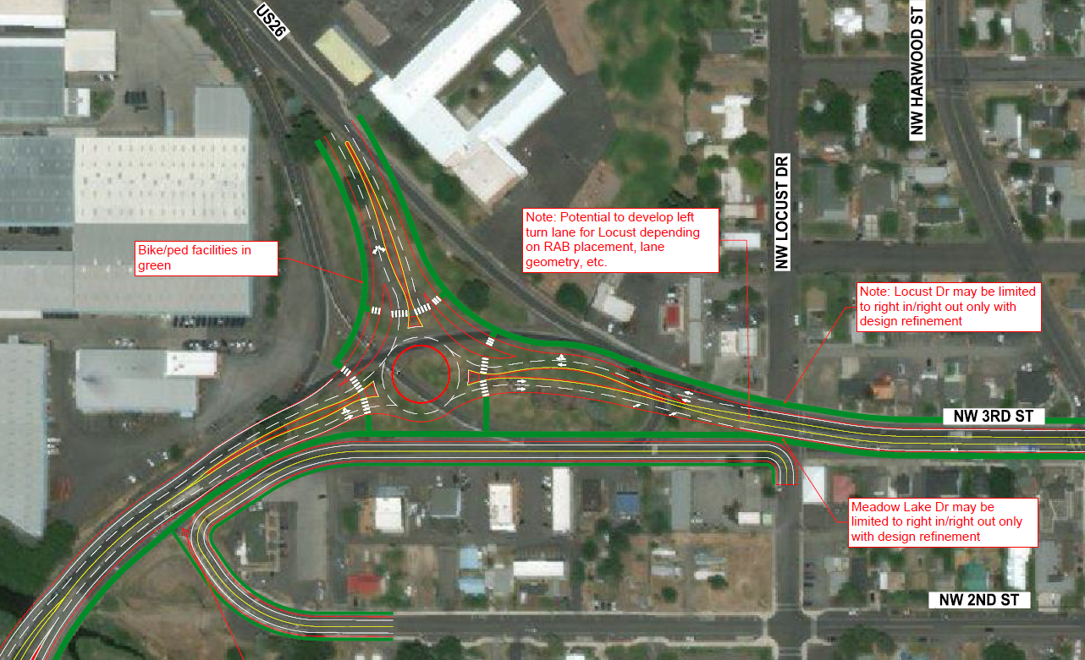
West Y
Roundabout concept to address safety, congestion issues
Would increase overall throughput of OR 126/3rd Street
Notes:
Would reconfigure ramps today that don't oeprate well today and is expected to operate very poorly in future.

Slide 46
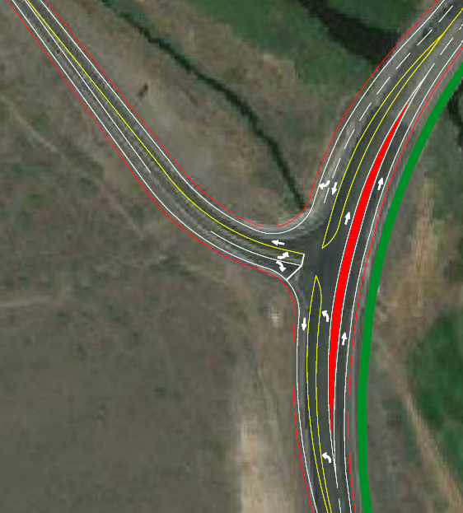
O’Neil Highway
Intersection reconfiguration to reduce turning crashes
Would handle increased traffic volumes better
Notes:
High volumes of left turns
Crashes with someone turning right, car going around and hit left turning vehicle.

Slide 47
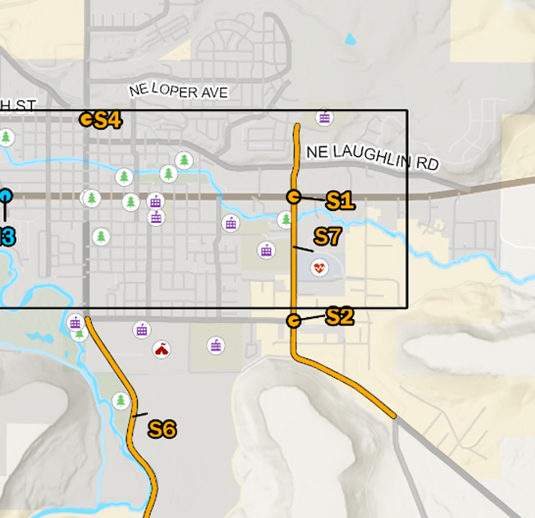
Other Projects
Widen Combs Flat between Lynn and 3rd Street to arterial standards
Lynn/Combs Flat intersection: near term - lighting, signage, site distance improvements
  Long term: intersection control evaluation

Slide 48
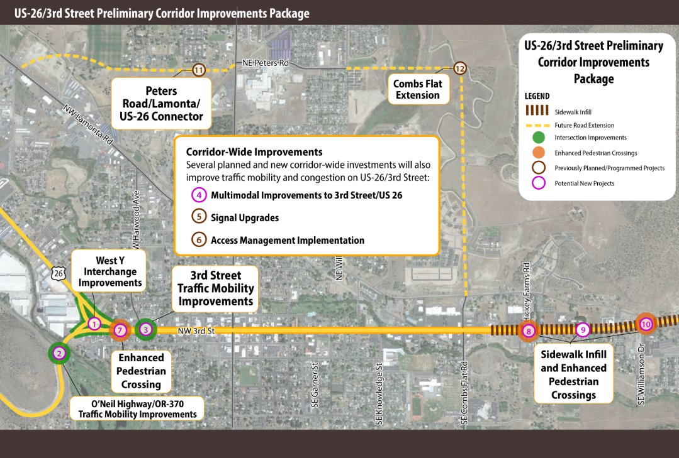
Notes:
Intended to take pressure off of 3rd with Peters Road and Combs Flat extensions.
R-1 9th street connection – offering more opportunities to link to regional connections.
Signal upgrades ODOT tie in signals on 3rd.
Access mgmt strategy that would consolidate driveways in the future to reduce turning conflicts.
Cyclists on 2nd/4th (parallel routes)

Slide 49
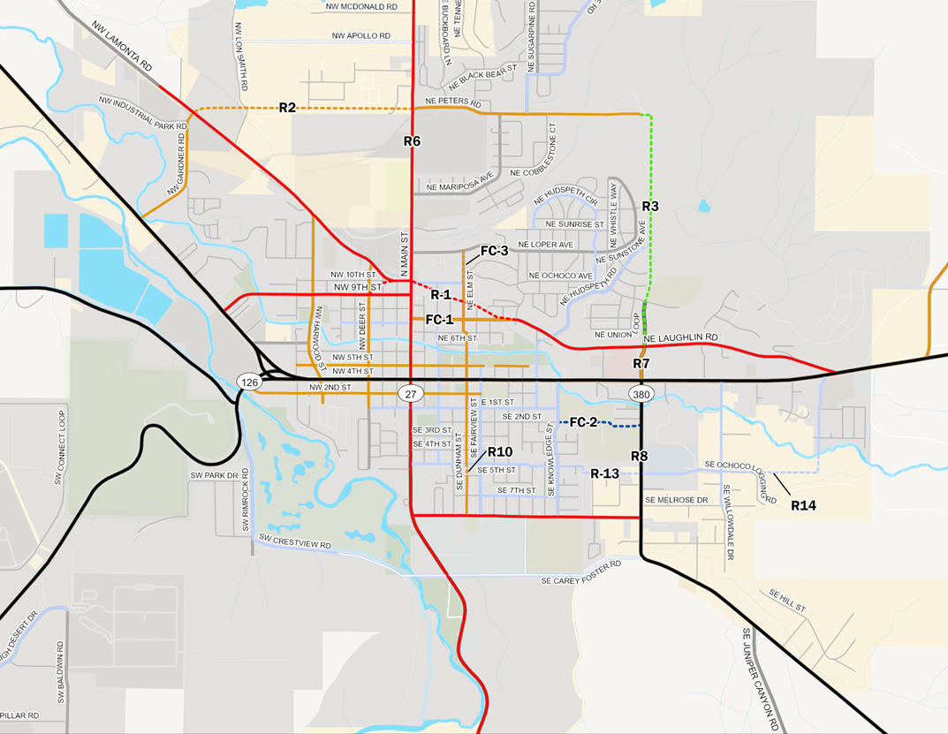
New connections
New connections to Lamonta, US 26, recently completed Combs Flat Extension
9th Street extension
All reduce traffic on 3rd Street

Slide 50
TSP Projects Summary
Projects organized by priority

Slide 51
TSP Projects Summary
Project ID | Project Name/Location | Improvement Time Frame | Cost Estimate | Possible Funding Source
R-3A | OR 126 & SW Parrish Ln: Widen OR 126 from SW Valley View Rd to Stillman Rd (center two-way left-turn lane). | Near | $900,000 | ODOT, Local Funds
JC-1 | Juniper Canyon Access: Develop new roadway connection in Juniper Canyon between Davis Loop and OR 27. | Near | $9,300,000 to $20,000,000 | Local Funds, Grants
JC-2 | Juniper Canyon Access: Develop new gravel roadway connection in Juniper Canyon between SE Simpson Rd and OR 380 | Near | $24,000,000 to $52,000,000 | Local Funds, Grants

Slide 52
TSP Projects Summary
Project ID | Project Name/Location | Improvement Time Frame | Cost Estimate | Possible Funding Source
S-3A | S Powell Butte Hwy & Alfalfa Rd: Install lighting and curve chevrons along S Powell Butte Hwy. Reassess curve warning signage and check for sign spacing. | Near | $71,000 | Local Funds, Grants
S-4 | OR 126 east of Powell Butte Hwy to Copley Rd: Widen edge line striping. | Near | $260,000 | ODOT
S-5 | OR 370 east of Happy Hollow Dr: Install rumble strips and/or wider edge line striping. | Near | $22,000 | ODOT

Slide 53
TSP Projects Summary
Project ID | Project Name/Location | Improvement Time Frame | Cost Estimate | Possible Funding Source
S-6 | OR 380 south of NE 3rd St: Evaluate access management along the corridor. | Near | N/A | ODOT
S-7 | Juniper Canyon Rd variable speed limit: Implement variable speed limit based on weather conditions. | Near | TBD based on future evaluation | Local Funds
S-8 | Juniper Canyon Rd alignment delineation: Add raised pavement markers on SE Juniper Canyon Rd. Add edge-line rumble strips to SE Juniper Canyon Rd. | Near | $94,000 | Local Funds

Slide 54
TSP Projects Summary
Project ID | Project Name/Location | Improvement Time Frame | Cost Estimate | Possible Funding Source
S-9 | Juniper Canyon Rd Add or enhance horizontal curve signage and markings. | Near | $10,000 | Local Funds
S-10 | Powell Butte Rd Add or enhance horizontal curves pavement markings. | Near | $10,000 | Local Funds
T-3 | Dial-a-ride enhancements and transportation network company encouragement. | Near | Already adopted as part of other plans.
T-4 | Transit community outreach. | Near | Variable | ODOT City of Prineville Local Funds

Slide 55
TSP Projects Summary
Project ID | Project Name/Location | Improvement Time Frame | Cost Estimate | Possible Funding Source
R-1A | OR 126 & Powell Butte: Construct a single‑lane roundabout. | Medium | $3,400,000 | ODOT, Development, Local Funds
R-2A | OR 126 & SW Williams Rd: Construct a single-lane roundabout. Requires an Intersection Control Evaluation to determine appropriate traffic control change. | Medium | $3,400,000 | ODOT, Safe Routes to School, Local Funds
R-5 | OR 126 at Kissler Rd. Balance destination access with mobility and safety of the transportation system. | Medium | $20,000 | ODOT
R-6 | OR 126 at Copley Rd. Balance destination access with mobility and safety of the transportation system. | Medium | $20,000 | ODOT

Slide 56
TSP Projects Summary
Project ID | Project Name/Location | Improvement Time Frame | Cost Estimate | Possible Funding Source
R-7 | OR 126 at Minson Rd. Balance destination access with mobility and safety of the transportation system. | Medium | $20,000 | ODOT
R-8 | OR 126 at Yates Rd. Balance destination access with mobility and safety of the transportation system. | Medium | $20,000 | ODOT
R-9 | OR 126 at Wiley Rd. Balance destination access with mobility and safety of the transportation system. | Medium | $20,000 | ODOT
BR-1 | County Road 221 bridge over Paulina Creek (NBI Bridge 19083): Study cost of repairing or replacing this functionally obsolete bridge. | Medium | $30,000 | Local Funds, Grants

Slide 57
TSP Projects Summary
Project ID | Project Name/Location | Improvement Time Frame | Cost Estimate | Possible Funding Source
BR-2 | SW Powell Butte Hwy bridge over Powell Butte Canal (NBI Bridge 03291): Replace bridge. | Medium | $1,500,000 | Grants
BR-3 | SW Powell Butte Hwy bridge over Powell Butte Wasteway (NBI Bridge 03293): Replace bridge. | Medium | $1,500,000 | Grants
BR-4 | Johnson Creek Rd NE bridge over Ochoco Main Canal (NBI Bridge 13C06A): Replace bridge. | Medium | $1,500,000 | Grants
BR-5 | Non-NBI bridge replacement program: Replace one non-NBI bridge per year. | Medium | $4,500,000 | Local Funds

Slide 58
TSP Projects Summary
Project ID | Project Name/Location | Improvement Time Frame | Cost Estimate | Possible Funding Source
S-2 | Rimrock Acres Loop & OR 370: Install lighting. Install raised pavement markings. Evaluate existing curve warning signage locations and warning speeds. Install curve chevrons, guardrail, and rumble strips. | Medium | $180,000 | Local Funds, Grants
S-11 | Davis Loop Rd Remove trees within clear zone. | Medium | TBD based on future study | Local Funds
S-12 | Powell Butte (OR 126) Install/maintain speed feedback signs. | Medium | $50,000 | ODOT

Slide 59
TSP Projects Summary
Project ID | Project Name/Location | Improvement Time Frame | Cost Estimate | Possible Funding Source
S-13 | US 26 Add systemic safety treatments, including edgeline rumble strips. | Medium | $50,000 | ODOT
S-14 | Lamonta Rd Install horizontal curve signage, speed feedback sign, and delineators. | Medium | $50,000 | Local Funds
S-15 | OR 126 Install systemic safety treatments, including edgeline and centerline rumble strips. | Medium | $50,000 | ODOT

Slide 60
TSP Projects Summary
Project ID | Project Name/Location | Improvement Time Frame | Cost Estimate | Possible Funding Source
B-1 | OR 126 from SW Powell Butte Hwy to Prineville urban growth boundary: Add shared-use trail along the south side of OR 126. | Medium | $6,600,000 | ODOT, Local Funds
B-8 | OR 27 Add shared-use trail to connect to planned path in Prineville. | Medium | $4,400,000 | ODOT, Local Funds
B-9 | Countywide Add bicycle route signage. | Medium | $50,000 | Local Funds

Slide 61
TSP Projects Summary
Project ID | Project Name/Location | Improvement Time Frame | Cost Estimate | Possible Funding Source
P-1A | OR 126 and SW Williams Rd: Install sidewalk, curb and gutter, curb ramps, and intersection lighting. Install marked crosswalks on all four legs of the intersection. | Medium | $2,900,000 | ODOT, Local Funds, Sidewalk Improvement Program
T-1 | Crook County Service Enhancement Plan: Institute evening and Saturday limited circulation as part of Route 26 flex route. | Medium | Already adopted as part of other plans.
F-2 | US 26 railroad bridge feasibility study. | Medium | $35,000 | ODOT

Slide 62
TSP Projects Summary
Project ID | Project Name/Location | Improvement Time Frame | Cost Estimate | Possible Funding Source
R-4A | SE Juniper Canyon Rd & OR 380: Realign intersection with left acceleration lane. | Long | $2,100,000 | Local Funds
S-1 | S Powell Butte Hwy & SW Bussett Rd: Install rumble strips along the curve. Implement variable speed limits that lower in icy conditions. Install lighting. Reassess curve warning signage and check sign spacing. Install acceleration lanes on S Powell Butte Hwy. Reconstruct intersection to simplify circulation patterns and turning movements. | Long | $870,000 | Local Funds, Grants

Slide 63
TSP Projects Summary
Project ID | Project Name/Location | Improvement Time Frame | Cost Estimate | Possible Funding Source
B-2 | Barnes Butte Rd: Add paved shoulder to Barnes Butte Rd. | Long | $3,800,000 | Local Funds
B-3 | Barnes Butte Shared-Use Trail Connections: Add shared-use trail connecting Barnes Butte Rd to Iron Horse shared-use trail in Prineville. | Long | $4,900,000 | Local Funds
B-4 | OR 27 Scenic Bikeway Bicycle Hub. Construct a bicycle hub, or "rest stop," for hikers, bicyclists, recreationalists, and community members along the OR 27 scenic bikeway corridor; provide small shelter, information kiosk (map/community calendar), bicycle tool station, and bench/sitting area. | Long | $30,000 | Private Partnership

Slide 64
TSP Projects Summary
Project ID | Project Name/Location | Improvement Time Frame | Cost Estimate | Possible Funding Source
B-5 | US 26 (Madras Highway) shared-use trail: Extend existing shared-use trail northwest to the county line parallel to US 26. | Long | $7,100,000 | ODOT, Local Funds
B-6 | Houston Lake Rd, SW Williams Rd, and Reif Rd Add shared-use trails. | Long | $10,500,000 | Local Funds
B-7 | Juniper Canyon Rd (south) Add paved shoulders. | Long | $5,400,000 | Local Funds

Slide 65
TSP Projects Summary
Project ID | Project Name/Location | Improvement Time Frame | Cost Estimate | Possible Funding Source
T-2 | Fixed-route enhancements to increase service in Prineville and expand connections to destinations. | Long | TBD | CET City of Prineville Local Funds
F-1 | Bus Evans Rd and Elliott Ln. | Long | $15,000,000 | Local Funds Grants

Slide 66
Funding and Implementation

Slide 67
Project Costs (2024 $)
Total TSP Project Costs: $112.9 million
  Projects in partnership with ODOT: $27.5 million
  Locally-led projects: $85.4 million
County has no dedicated source of funding for transportation.
  New funding sources are needed.

Slide 68
Funding Sources
Grants
  BUILD (Federal)
  Earmark (Federal/State)
  Building Resilient Infrastructure and Communities (Federal)
  Statewide Transportation Improvement Program (State)
  Federal Lands Access Program (Federal)
Local Options (Potential)
  System Development Charge
  Developer-built
  General fund
  Local Improvement District
  Special Road District
  Tax Increment Financing
Notes:
BUILD – Better Utilizing Investments to Leverage Development
STIP – Statewide Transportation Improvement Program
FEMA BRIC – Building Resilient Infrastructure and Communities
FLAP (Federal Lands Access Program)
SDC – System Development Charge
LID – Local Improvement District
SRD – Special Road District
TIF – Tax Increment Financing

Slide 69
How do Projects Get Done?
Smaller projects: County lead, use local funds if available
Major Projects:
  Identify possible funding sources, build coalition
  Refine the project, costs, and design
  Additional public outreach
  Multiple years to complete
Seek Grants: Some have more onerous requirements than others.
Opportunism: New grant opportunities, project underruns mean more $ for another project elsewhere, developer exactions
Developer: New development contributes to SDCs

Slide 70
Next steps
Planning Commission TSP Hearing: September 24, 2025
Board of Commissioners Hearings:
  October 1, 2025
  October 15, 2025
Finalize TSP

Slide 71
Thank you!

