Slide 1
County Counsel Office / Legal Department
Mission
Provides legal advice and services to Crook County, including, as appropriate, its employees, elected officials, agents, and legally authorized representatives acting in their official capacities, and any other administrative services as may be directed.
Major goals
Facilitate transition to County Administrator
Develop and present training as requested
Offload all non-legal functions
Property management
Purchasing
Public information request
Fees and charges to Finance
Compensation committee to Human Resources
Other as identified
Transition to exclusively provide legal services and related training
Notes:
Enter your department in Header area
Enter the department’s mission statement
Enter the department’s major goals/work plan elements
Add the department logo to bottom left corner, same size as County logo

Slide 2
County Counsel Office / Legal Department Financial Summary amounts in thousands
 | Budget | Actual | Variance
Expenses | $ 452k | $ 172k | $ 280k
Comments
Large expenditure in November for attending annual AOC conference.
The vacancy in the office manager position was filled, and department has been operating on full capacity this quarter.
Internal service charges recover full cost.
Notes:
Enter department in header
Enter the department’s quarterly budget, actual and variance amounts ---- in thousands
Enter comments to explain any significant variances
Add the department’s logo to the bottom left corner, same size as County logo

Slide 3
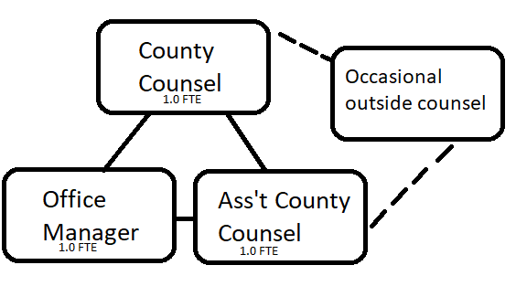
County Counsel Office / Legal Department Staffing Summary
Comments:
ORS 203.145: “…the board of each county may appoint a person or persons licensed to practice law in the State of Oregon as counsel to advise the board and other county officers, to render services in connection with legal questions of a civil nature arising in the discharge of their functions, to prosecute violations of county law […], and to provide such additional services as the board determines. Counsel shall serve at the pleasure of the board, on a full- or part-time basis….”
RPC 1.13: “A lawyer employed or retained by an organization represents the organization acting through its duly authorized constituents.”
Org Chart
Staffing Summary
Authorized | Filled | Vacancies
3 | 3 | 0
Notes:
Enter department in the bottom header
Enter the department’s organization chart
Provide some bullets describing personnel during the quarter, e.g., number of new employees, separations, etc.any pending recruitments, significant new hires or seprarations
Enter the department’s authorized, filled and vacate positions – FTEs as of end of the quarter
Add the department logo to the left of the County logo – same size as County logo

Slide 4
County Counsel Office Activities Q1 FY 2024
Goal/work plan description | Activity during quarter | Comments
Facilitate transition to County Administrator | Contract administrator engaged
Develop and present training as requested | Drafted updates to Procurement code, for presentation at dept. head meeting | If code is updated, training can be scheduled on new rules
Transition to exclusively provide legal services and related training | Increased department litigation: dog nuisance cases, code compliance cases, & declaratory judgment suit
Notes:
Replace “Department” with your department name in header
List the major goals/work plan elements for the department
Provide a brief description of activity on each goal/work plan item
List any challenges or changes or other comments for each goal/work plan item
Add additional lines as needed – go to next page if needed
If additional page added, delete “Questions”
Add department logo to left of the County logo – same size as County logo

Slide 5
County Counsel Office Activities - continued Q1 FY 2024
Goal/work plan description | Activity during quarter | Comments
Offload all non-legal functions Property management Purchasing Public information request Fees and charges to Finance Compensation committee to Human Resources Other as identified | Fee schedule transitioned to Finance Department. Compensation committee transitioned to Human Resources. | Office is still involved with purchasing, public records request responses, and property management.
Notes:
Replace “Department” with your department name in header
Continue your list of the major goals/work plan elements
Provide a brief description of activity on each goal/work plan item
List any challenges or changes or other comments for each goal/work plan item
Add additional lines as needed – go to next page if needed
If additional page added, delete “Questions”
Add your department logo to left of the County logo – same size as County logo

Slide 6
County Counsel Office Performance Measures Q2 FY 2024
Performance measure | Goal | Actual | Comments
• Increase routine operations training for County staff to improve knowledge of important areas of public duties • Proactively reduce the amount of time spent “getting up to speed” on a topic by cross training staff on legal subject matters | Develop and present training as requested Transition to exclusively provide legal services and related training | Draft public records training prepared. New rule having departments draft their own memos to County Court is a big help | Hope is to schedule public records trainings in March or April, with public contracting in April or May. Litigation matters comprise a great deal of staff time this quarter.
Questions
Notes:
Replace “Department” with your department name in header
Enter performance measures, goal and actual, with comments --- use performance measures included in the budget as a starting point, additional measures are encouraged
Add your department logo to left of the County logo – same size as County logo

